Slide 1
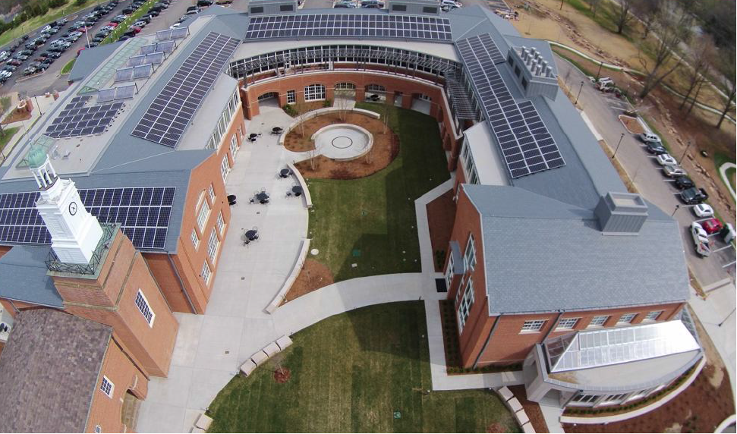

Slide 2
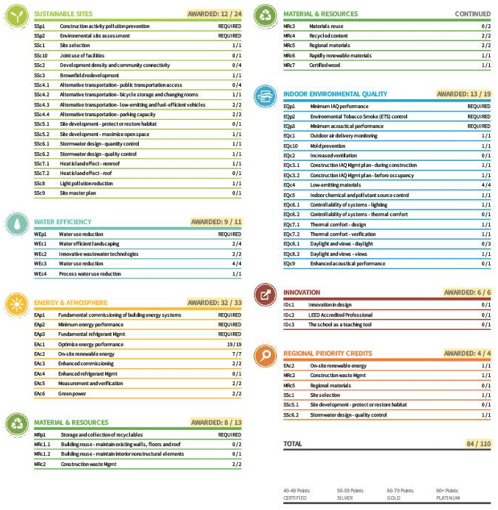
LEED

Slide 3
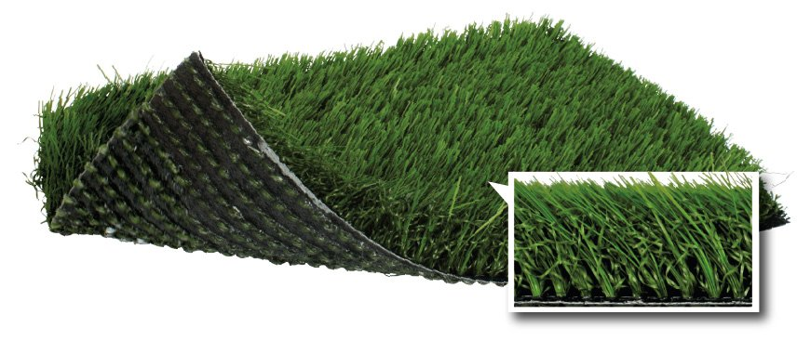
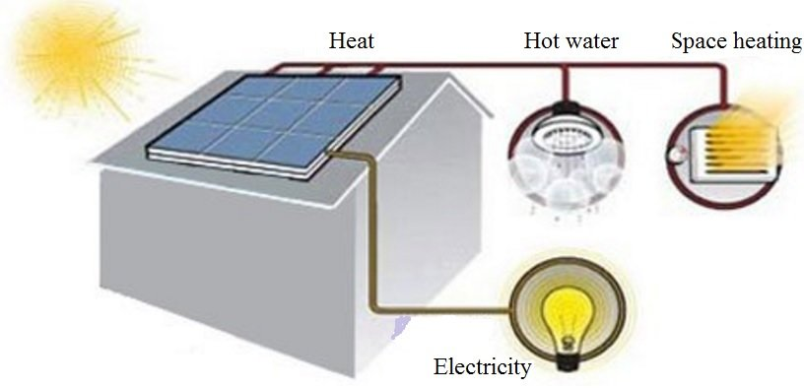
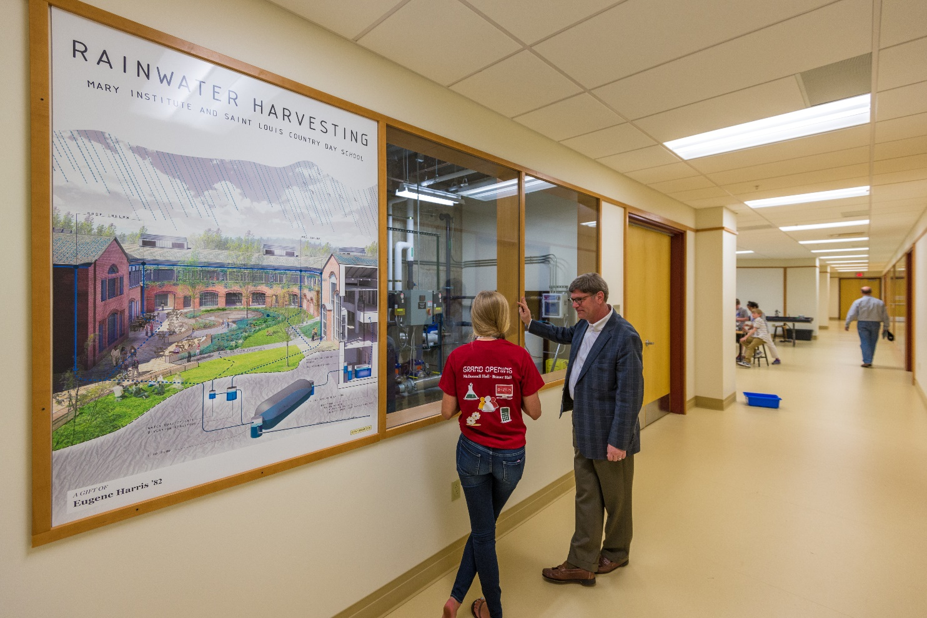
Methods to improve efficiency

Slide 4
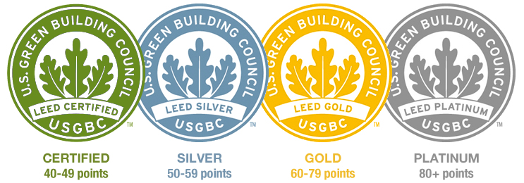
LEED

Slide 5
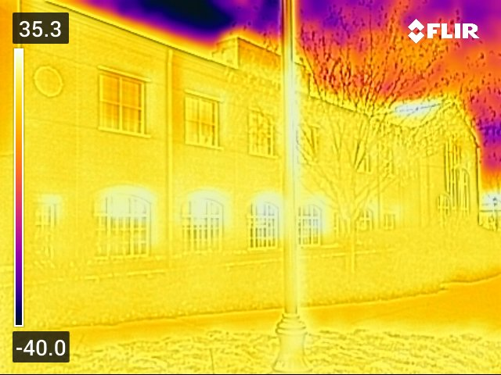
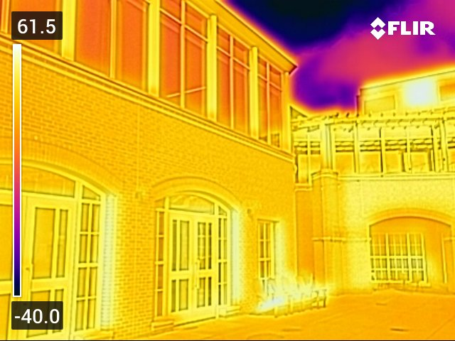

Slide 6

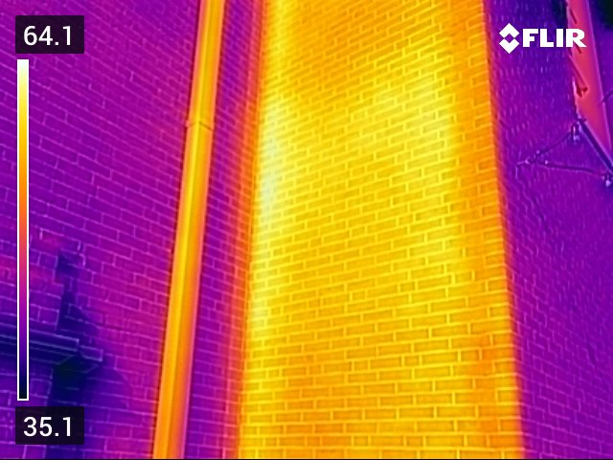
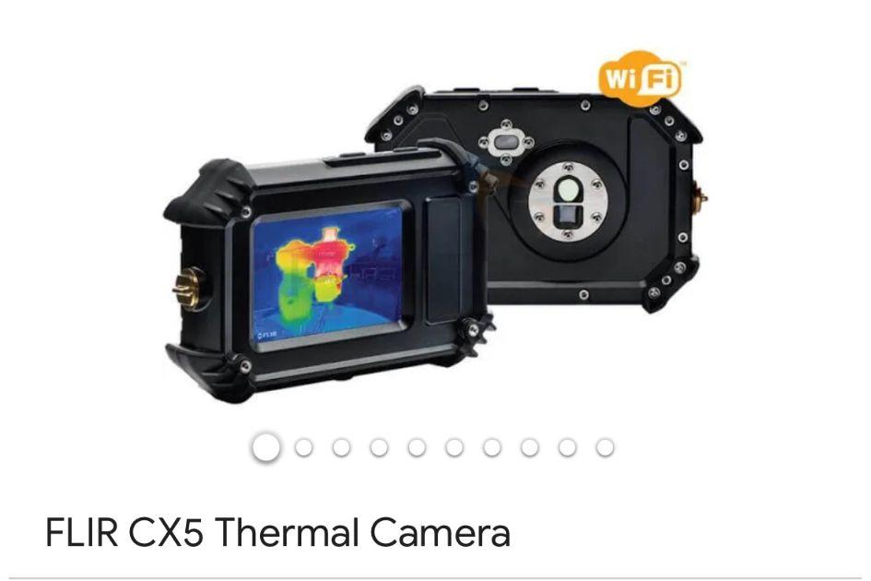
Data

Slide 7
Uptale
https://my.uptale.io/experience/Launch?id=5fJUCV5dkimTpNWRzctA&playbackMode=Smartload&world=6c22814b-ab7e-4e23-9d24-bffc93571e6e
https://my.uptale.io/experience/Launch?id=sUOACykK0uLl42v1Mh5Cw&playbackMode=Smartload

Slide 8
Sources
MICDS2020GRS_FullPackage. “MICDS2020GRS_FullPackage.” Google Docs, 2020, docs.google.com/document/d/1ZnnwHDBLsD_pVfO0QWFFfosXBvhKfPNrPn6yrVrcK8s/edit. Accessed 14 Dec. 2023.
McDonnell. “McDonnell Hall and Brauer Hall Tour Talking Points.Admissions.docx.” Google Docs, 2019, docs.google.com/document/d/1rr3vXnut27e21m7vNA-taIT6TBxBhQRS/edit. Accessed 14 Dec. 2023.
Woodard, John. “What Is a UV Water Purifier and How Does It Work?” Fresh Water Systems, Fresh Water Systems, 2023, www.freshwatersystems.com/blogs/blog/what-is-a-uv-water-purifier-and-how-does-it-work#:~:text=An%20ultraviolet%20(UV)%20water%20purifier,microorganisms%20so%20they%20cannot%20reproduce. Accessed 14 Dec. 2023.

